Slide 1


Maintaining Momentum on the DE&I Journey during periods of disruption and uncertainty
Level 20 HR and DEI Professionals
Breakfast
Hosted by Blackstone
21st March 2023
Notes:
Intro

Slide 2

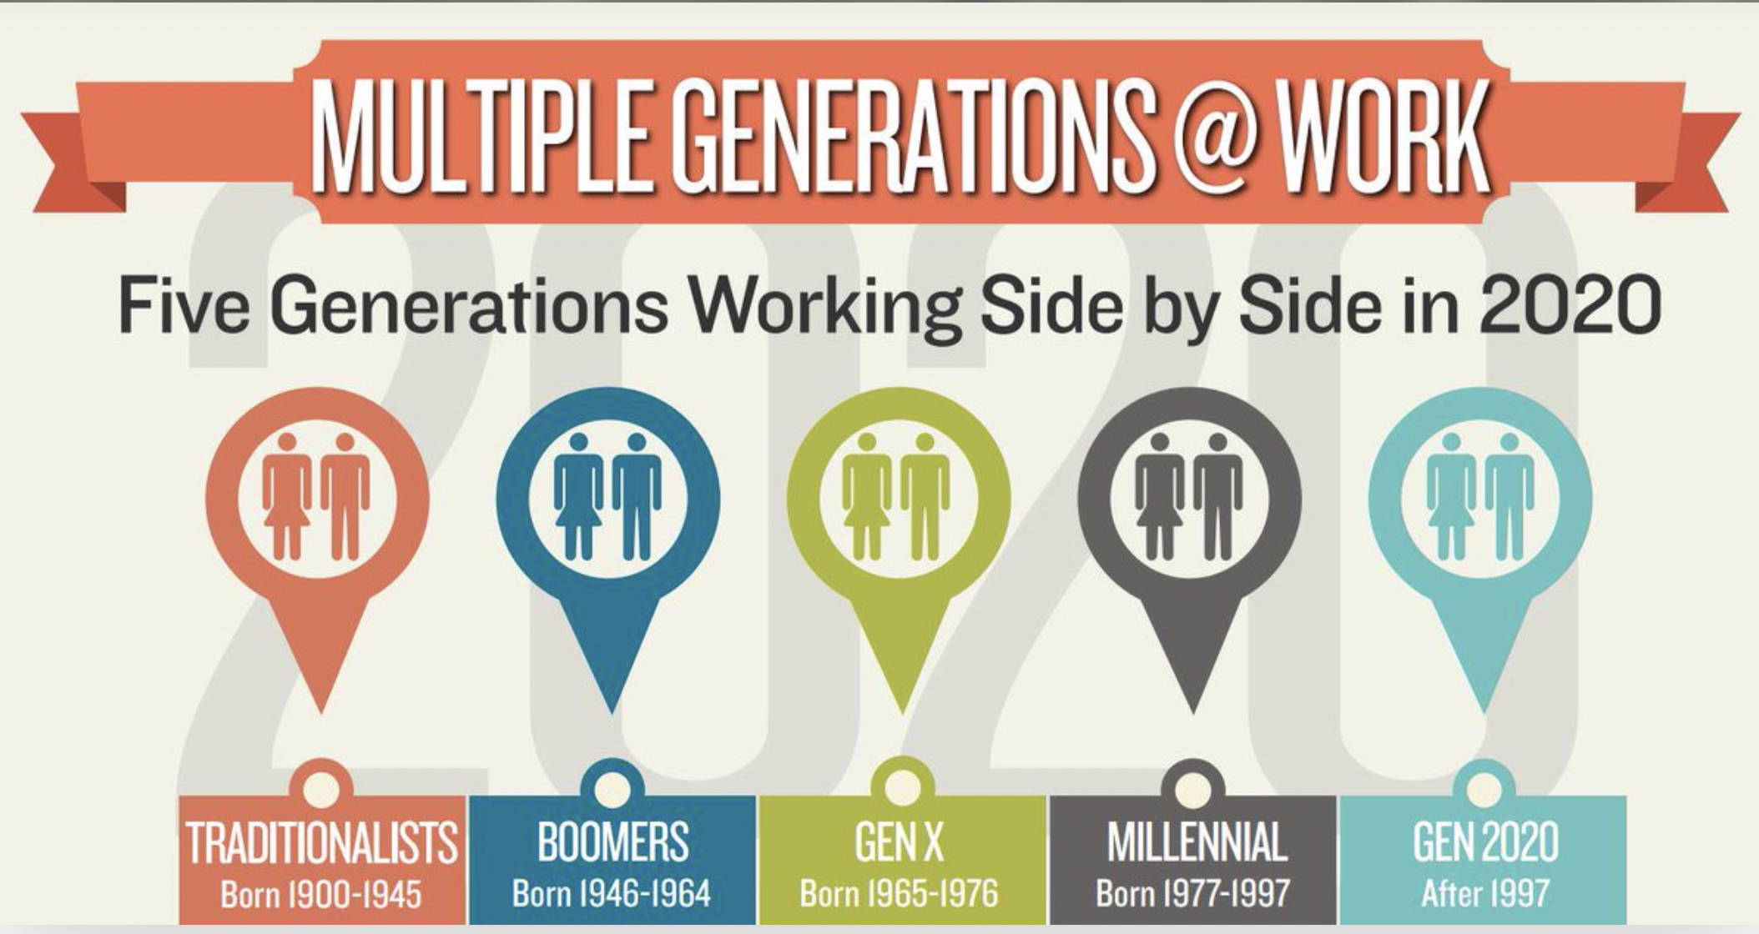




THIS IS NOW
© BEYOND THE BARRIERS ACADEMY. ALL RIGHTS RESERVED.
Notes:
The only thing constant in this world is change! Focus on cultural change..during disruption and uncertainty is the time to double down on DEI.

Slide 3



WHY?
WHAT?
HOW?
CLARITY / TRANSPARENCY / ACCOUNTABILITY
Notes:
So the first step in maintaining momentum is being clear as to your WHY, and this then shapes your DEI vision and mission statement.
- How does DEI align to your company values
Align your DEI focus to strategic growth strategy
Does it reflect the needs of your business and your people
Does everyone in the business understand it and champion in? What’s in it for them?
Are people aware that this is about making workplaces work for everyone – and that everyone stands to gain from getting it right
Not a zero sum game – need influential champions and advocates across all levels of the firm – and not only ‘diverse’ people.

Slide 4






High Performing Teams
Cognitive diversity can enhance team innovation by up to 20%
The diversity and inclusion revolution: Eight powerful truths, Deloitte (2018)
Commercial Advantage
Companies in the top quartile for gender and ethic diversity on executive teams are more likely to achieve above average profitability than companies in the fourth quartile.
(+25% by gender diversity, +36% by ethnic diversity)
Diversity Wins, McKinsey (2020)
Business Rationale for Diversity, Equity & Inclusion
Client and Community Engagement
Individuals aware of a brand’s supplier diversity initiatives were 45% more likely to perceive the brand as valuing diversity and 25% were more likely to think favorably about the brand.
Research for Coca Cola, Hootology (2019)
Fit for the Future
Organisations with inclusive cultures are 6x more likely to be innovative and agile
The diversity and inclusion revolution: Eight powerful truths, Deloitte (2018)
Employer of Choice
67% of job seekers consider workplace diversity an important factor when considering employment opportunities.
Diversity Hiring Survey, Glassdoor (2021)
The Right Thing To Do
“People matter, and we all should have equal opportunity to
develop, progress, and be rewarded and recognised at work.”
Diversity and Inclusion at Work, CIPD (2018)
Notes:
Time and again, research shows that the more diverse a company, the better its performance.
My position is that there is no business case for the status quo – and that DEI is not only the right thing to do it is also good for business. 30% Club research Hampton Alexander Review, the most recent Parker review, McKinsey

Slide 5
WHY?
WHAT?
HOW?
CLARITY / TRANSPARENCY / ACCOUNTABILITY
Notes:
What is the problem you are trying to solve – how does this connect back to your why.
Where should you focus – are you listening to your people? Assess and understand the present/current state, as this will help determine where to focus your efforts.
Best way to determine your what is through data collection and analysis.
Quantitive and qualitative data – highlights strengths and successes as well as inequities and shortcomings, identify both RISKS and OPPORTUNITIES.
Celebrate what you do well, and then engage people in where you need to focus if you’re to get the best from DEI. Communicate – big and small wins… keep the circle of communication open. People are becoming very disenfranchised and fatigued, as feels like people firms not walking the walk – making bold statements but not engaging people in progress, or challenges.

Slide 6






Learning & Development
Progression and promotion
Onboarding
Performance, Feedback & recognition
HOW!
Attraction, Recruitment and Selection
Exit
Notes:
DEI is about problem solving
DEI is a journey not a destination – and culture change takes time, it is a processes so needs ongoing iteration and celebration. The rationale for change should be aligned with the firms ethos and culture and strike a balance between honest and inspirational and hopeful.
DEI needs to be embedded into the DNA – into processes, policies, team and company culture behaviours. It also needs to be rewarded and recognized, and not just the minorities job to solve. Leaders have the power and influence to drive real change – lets empower them to do so.
Interventions are tools to achieve outcomes – what are the outcomes you are trying to achieve and how does this enable you to achieve you strategic growth goals. Keeping coming back to you why – this will give you clarity.
This is about prioritising where you focus – you cannot do it all at once. What are the key focus areas, that are going to help you solve the biggest challenges in your business. Is it attraction of talent, retention of talent, development of talent, This affects both men and women…
Need to communicate what you are doing, why you a doing it, and the impact of doing it – and who is accountable for the change. Reward and recognise those that do this well! Empower people to get involved.
Effective DEI strategies differ dramatically depending on whether an environment is high, medium or low trust. This is often based on whether or not people
Integrate don’t separate ESG and DEI. TRACK YOUR DATA!!

Slide 7
Group Discussion
What has been your greatest success story when it comes to DEI and how did you measure the success?
What has been the biggest challenge for you in implementing DEI at your firm and what was the solution you found?
What is the biggest lesson you have learnt since starting your DEI journey? (optional)

Slide 8
Maintaining Momentum in DEI - Top Tips
Remember DEI is a continuous process – it is cultural change (that takes time), not a set of events or activities
Get clear on your ‘why’ as it relates to your business, your values, your people and your growth strategy. Engage leadership to ensure they champion and lead from the top
Establish and track benchmarks, KPI’s and measurements and treat DEI as a vital business unit with clear accountability
Listen to the lived experiences of your people, to understand the current state and monitor progress. This will help shape your priorities
Engage champions and advocates across all levels of the firm/organization
Collect and analyse data – that goes beyond visible diversity; both quantitative and qualitative
Create and sustain a sense of belonging and psychological safety. Be clear as to expected behaviours
Empower people to get involved
Examine processes and implement a system that challenges bias, removes barriers and promotes equity
Promote and communicate your DEI plans; communicate your progress with transparency and celebrate your successes
Communicate your DEI vision, mission, strategy and progress externally
Align on what you mean by DEI and build awareness and understanding across the business – engage everyone as everyone stands to gain
Integrate, don’t separate ESG and DEI
Reward and celebrate exemplary DEI behaviours.
Notes:
Analyse

Slide 9
UPDATE

Slide 10
Stay With Me

Slide 11
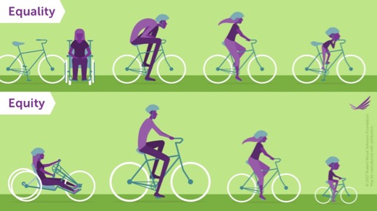
Equality vs Equity

Slide 12
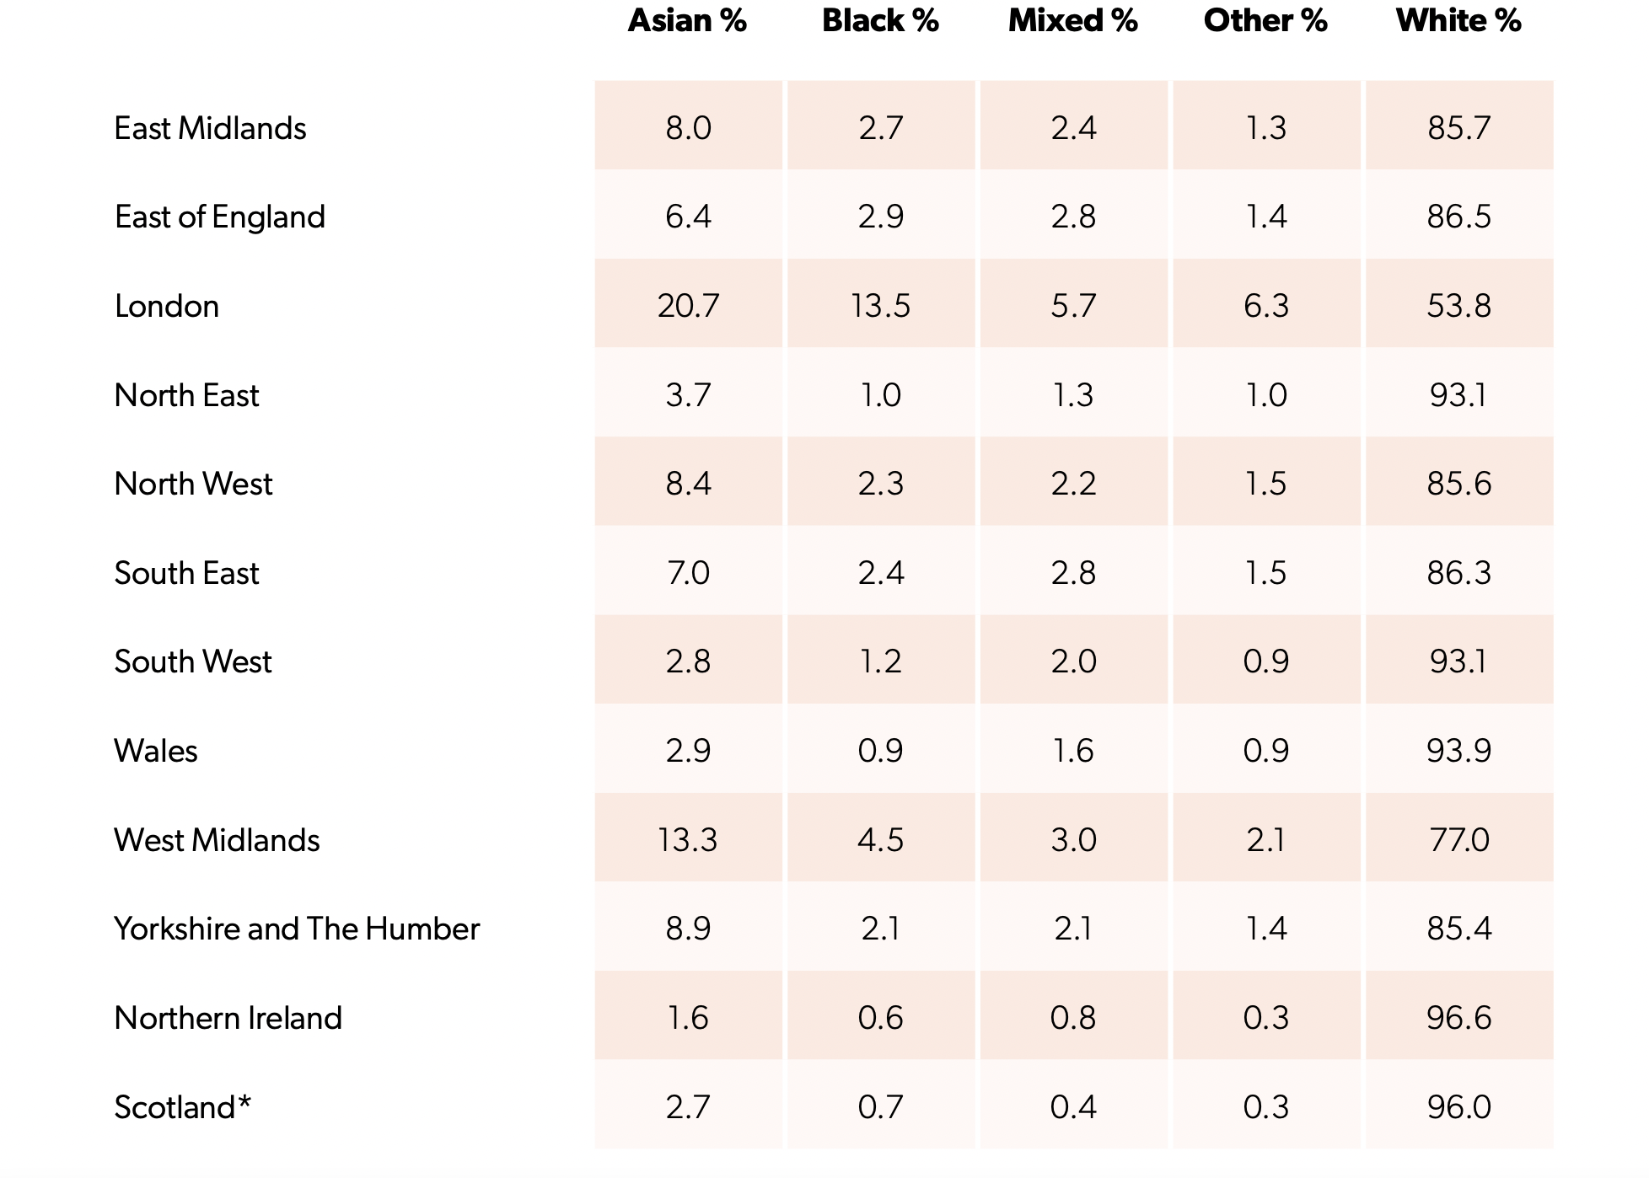
Census 2021 Areas of the UK by Ethnicity:
Source: 2023 Parker Review Report

Slide 13
Embedding Diversity, Equity and Inclusion in Your Culture
Vision and Impact
Embed and Sustain
Inclusive leadership, in hybrid world
Conscious inclusion
Women In Leadership
Sponsors to Success Partner
Active Allyship
Creating Psychological Safety
Wellbeing linked to DEI
Current state diagnostic and analysis (DEI maturity)
Narrative for change – the why and why now (North star alignment, cultural blueprint)
Facilitated conversations/focus groups
Employee lifecycle mapping through lens of equality
DEI activation coaching for leaders
Communication and listening survey’s
Upskill and Transform
Examples of opportunities to develop your DEI priorities and roadmap

Slide 14

Stay With Me
Contact us for further discussion on:
Phone: +44 7968 509 695
Email: belinda@belinda-riley.com
www.linkedin.com/in/belinda-riley/

